Slide 1

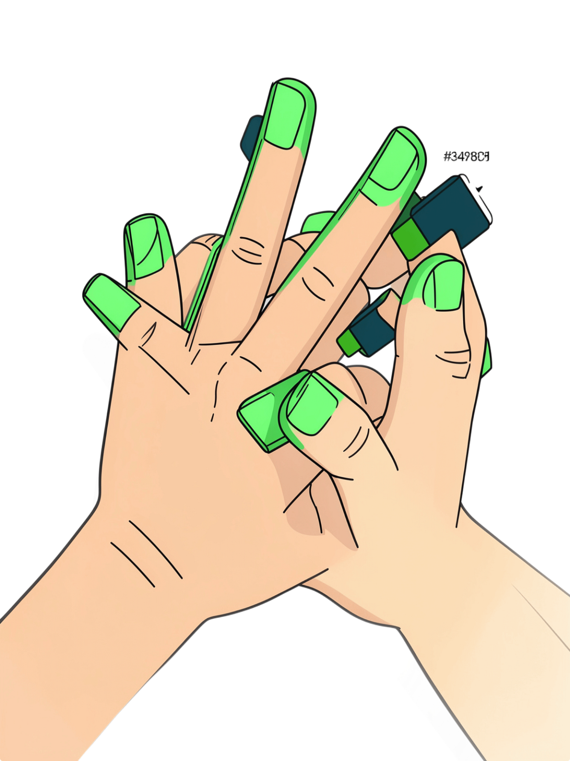

REVIEW-1
Sign Language Translator
Course Name : DATABASE SYSTEMS ENGINEERING AND DISTRIBUTED BACKEND DEVELOPMENT
Course Code : 25CS1302E
Team 5 — Section 12
2520090004 -Lahari
2520090152 – Devaji Rashmika

Slide 2
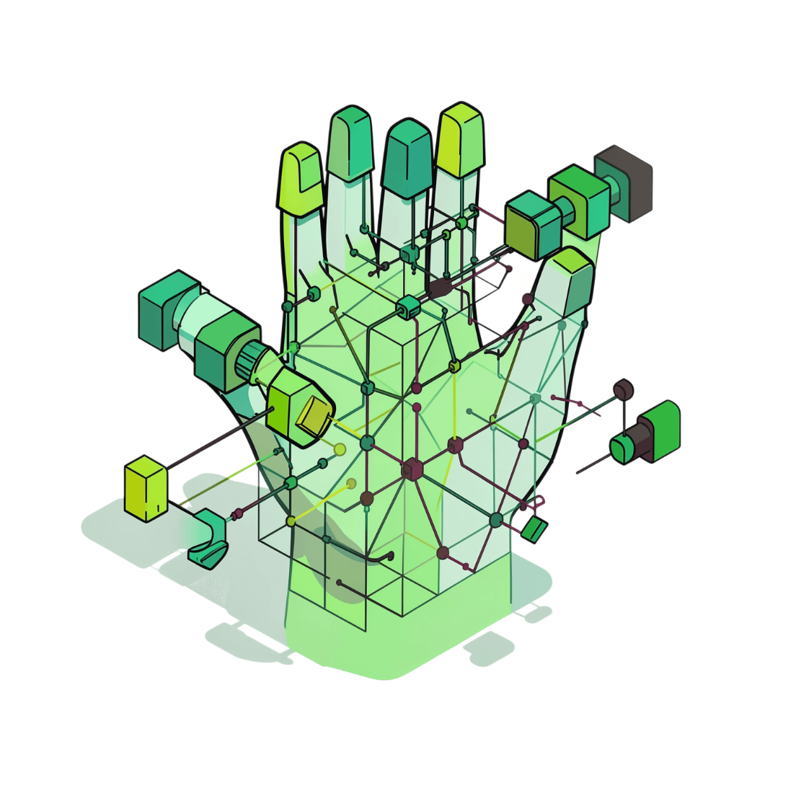
Abstract
Communication is a basic human need, but people who use sign language often face difficulties communicating with others who do not understand it. The Sign Language Translator is a database-driven application that recognises hand gestures in real time and converts them into text and speech.
The system uses a webcam to capture gestures, OpenCV to process video frames, and MediaPipe to detect hand landmarks. An AI/ML model classifies the gestures and displays the recognised sign as text, with an optional speech output. The user interface is developed using HTML, CSS and JavaScript.
MongoDB stores user details, signs, categories, meanings and translation history. Users can register, log in, search for signs and view previous translations. Overall, the project combines database management, computer vision and machine learning to provide an affordable and accessible real-time communication solution.

Slide 3

Introduction
Sign Language
Communication Barriers
A visual-spatial language using hand gestures, facial expressions, and body movements to communicate.
Sign-language users often struggle to interact with non-signers, limiting accessibility in daily life.
AI & Computer Vision
Project Goal
Enables automated, real-time recognition of hand gestures and their meanings.
Bridge the communication gap through an intelligent, automated gesture recognition system.
System Workflow: Hand Gesture → Camera → Image Processing → AI/ML Model → Recognized Sign → Text/Speech

Slide 4
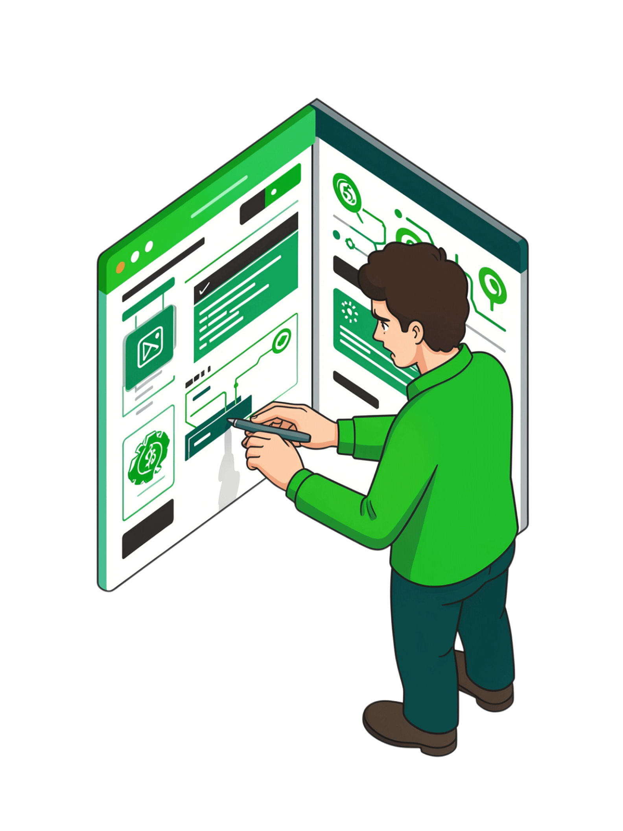
Problem Statement
The Challenge
The Solution
People who communicate using sign language face significant difficulties when interacting with those who do not understand it.
An automated real-time system that recognizes sign language gestures and converts them into understandable text or speech accessible to everyone, anywhere.
Communication Barriers: Limited accessibility in public spaces, education, and healthcare
Lack of Translators: Professional interpreters are expensive and not always available
Need for Real-Time: Manual translation is too slow for practical use
Affordability: A cost-effective solution is essential for widespread adoption

Slide 5
Objectives
01
02
Capture Gestures
Detect & Process
Capture sign-language gestures using a camera in real-time
Detect and process hand gestures from video frames
03
04
AI Classification
Text Output
Recognize individual signs using an AI/ML classification model
Convert recognized gestures into readable text output
05
06
Speech Feedback
User-Friendly Tool
Optionally convert resulting text into speech for audio feedback
Provide a simple, accessible communication interface for all users

Slide 6
Software Used
Software
Purpose
Python
Main programming language
OpenCV
Image processing and computer vision
MediaPipe
Hand detection and landmark extraction
MongoDB
Stores user details, sign information, and translation history
HTML, CSS, JavaScript
User interface and interaction

Slide 7
Hardware Used
Hardware
Purpose
Laptop / PC
Processing and application execution
Webcam
Real-time gesture capture
Microphone
Audio input
Speaker
Speech output

Slide 8
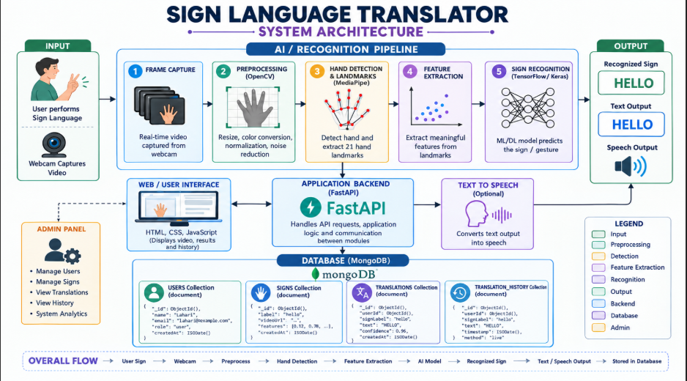
Capture Gesture
Preprocess Frame
Detect Hand
Classify & Output

